Slide 1
Economic and Monetary union: from 1957 to the Euro Crisis
By: Alexis Drach (2024)
Isabelle Samuel

Slide 2
Historical Context
1944
Post WWII: The Bretton Woods system: fixed exchange rates tied to the US dollar and provided stability
1957
Treaty of Rome: Began economic cooperation in Europe
1970
Turning point: Collapse of Bretton Woods and global monetary uprisings forced Europeans to seek unique “European monetary identity”

Slide 3
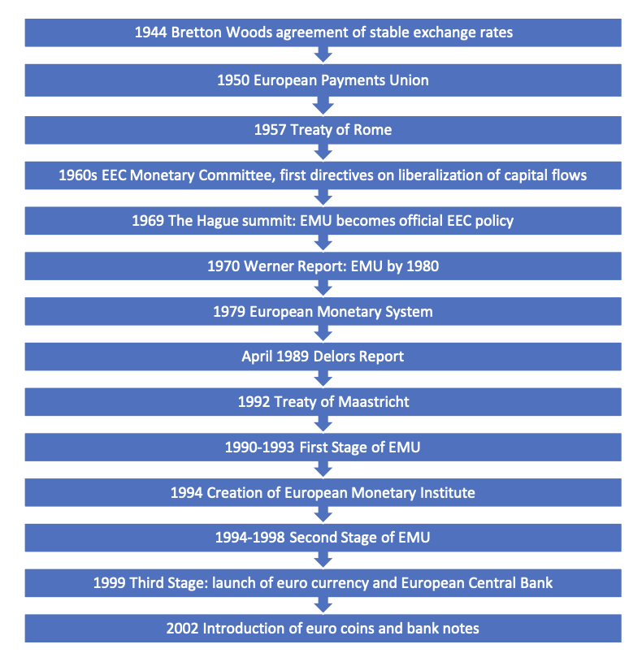
Timeline of economic and monetary union

Slide 4
Who is Alexis Drach?
French economic historian
He specializes in European monetary integration and financial history
Drach argues that the EMU is
An incomplete and unbalanced project, where monetary integration advanced faster than economic and political integration
-Not just economic but deeply political too
Critical of the “monetarist” approach (Europe introduced the currency first and expected convergence later
He suggests that the economies were not ready to share a currency

Slide 5
Overview
What is EMU?
A system to create and manage a single European currency
Three phases
Early monetary experiments (1960s-70s)
Road to the Maastricht Treaty (1980s-90s)
Euro crisis and reforms (2009-present)
The Core Conflict : Constant tension between maintaining national interests and achieving the high degree of economic integration required for a single currency

Slide 6
Themes to Highlight
Sovereignty:
Countries gave up control over their own currency
This is a significant loss of state power and is very rare
Economic Coordination:
A currency union needs shared rules and discipline and is unstable without the “E” in EMU
This included shared budget rules and banking supervision
Political Dimension:
Embedded in social and political contexts which affects employment, growth and stability

Slide 7
Foundations & Early Projects (1960s-70s)
1972
“The Snake”: A system established to narrow fluctuation margins between European currencies to 2.25%
1979
The EMS (European Monetary System): Created the European Currency Unit (ECU) and credit mechanisms to stabilize the market
These were early attempts to control instability, but not fully successful

Slide 8
The Debate- Economists vs Monetarists
The "Monetarist" View:
Argued that a shared currency would force economies to converge
Currency first and convergence later
The "Economist" View:
Believed economic alignment was a prerequisite for union
Convergence first and currency later
Europe moved ahead before full economic alignment
National Divisions : Generally, France favored the monetarist view, while Germany and the Netherlands favored the economist view

Slide 9
Building the Euro
The Single Market (1992) :
Policymakers like Jacques Delors argued that a monetary union was necessary to complete the internal market and eliminate trade barriers
The Delors Report (1989) :
Proposed a three-stage plan for EMU, which influenced the Maastricht Treaty
Coordination of policies
Creation of institutions
Introduction of a single currency
Maastricht Treaty :
Established strict rules for joining, including price stability, debt limits and inflation
Result: Creation of the euro framework

Slide 10
The 1992-93 EMS Crisis
Financial pressure:
Global investors speculated against weaker European currencies
Markets tested whether governments could maintain their fixed exchange rates
Black Wednesday (1992)
The UK was forced to leave the system
- exchange rate margins widened significantly (15%)
Revealed:
Markets were stronger than individual governments
European economies were still too different
Monetary cooperation was fragile without deeper integration

Slide 11
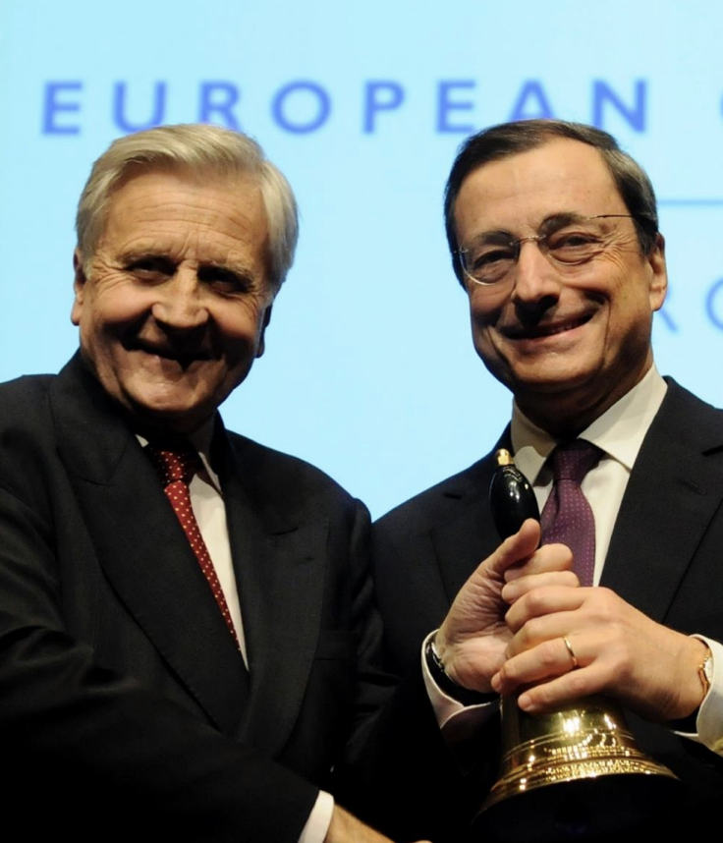
The Euro Crisis (2009)
The Trigger:
Greece’s 2009 announcement of 12.7% deficit sparked a wider debt crisis
Spread across several Eurozone countries
Structural flaws:
The crisis exposed a “bank-state doom-loop” and a lack of mechanisms for “fiscal transfers” to poorer regions.
Weak coordination and strong links between banks and government
The ECB’s (European Central Bank) role:
Mario Draghi’s promise to do “whatever it takes” in 2012 was critical to saving the currency (the euro)
ECB played a key role in preventing the collapse of the euro

Slide 12
Conclusion
The euro is central to European integration and to the wider European project.
Benefits
Stability
Easier to trade
Global influence
Costs
Loss of national control and flexibility
EMU evolved through crises and political decisions
No simple path and growth through crises and political will

Slide 13
Tone of Drach
Realistic:
Portrays the history of the EMU not as a steady march towards progress but as a “multifaceted history, with no simple path”
Analytical regarding weaknesses:
He maintains a critical academic distance, saying that 2009 crisis was not a surprise to everyone but revealed structural weakness
Balanced Perspective
Space for competing theories such as the “economist” vs “monetarist” debate
Skeptical but acknowledge resilience
Labels the unions architecture as “incomplete” but acknowledges the “centrality” of the euro to the wider European project and the political commitment that has allowed it to survive

Slide 14
Relevance Now
Euro is a success of integration and it remains a work in progress!
Banking Union (1998)
A major outcome was moving bank supervision to the European Central Bank (ECB) via the Single Supervisory Mechanism
Continued gaps in the system:
Experts agree that the EMU is still incomplete (regarding a common European Deposit Insurance scheme)
Ongoing debates
The balance between austerity (reducing government spending and increasing taxes) measures and economic growth

Slide 15
Questions?
Alexis Drach. Economic and monetary union: from 1957 to the euro crisis. Brigitte Leucht; Katja Seidel; Laurent Warlouzet. Reinventing Europe: The History of the European Union, 1945 to the Present, Bloomsbury Academic, pp.183-202, 2023, 978-1-350-21308-1. ffhal-04475213f

